Slide 1
Circumference of a circle
Task A: Using a formula to calculate the circumference
1) Calculate the circumference of each circle. Give each answer: i) in terms of π; ii) rounded to 3 significant figures.
a)
i) 9π cm
b)
i) 10π cm
9 cm
ii) 28.3 cm
5 cm
ii) 31.4 cm
c)
d)
12 cm
i) 11π cm
i) 12π cm
5.5 cm
ii) 34.6 cm
ii) 37.7 cm
2) Calculate the circumference of each circle. Give each answer rounded to 1 decimal place.
a)
b)
c)
d)
14 m
17 m
4.1 m
22.8 m
11.4 m
8.2 m
1 m
71.6 m
71.6 m
25.8 m
12.6 m

Slide 2
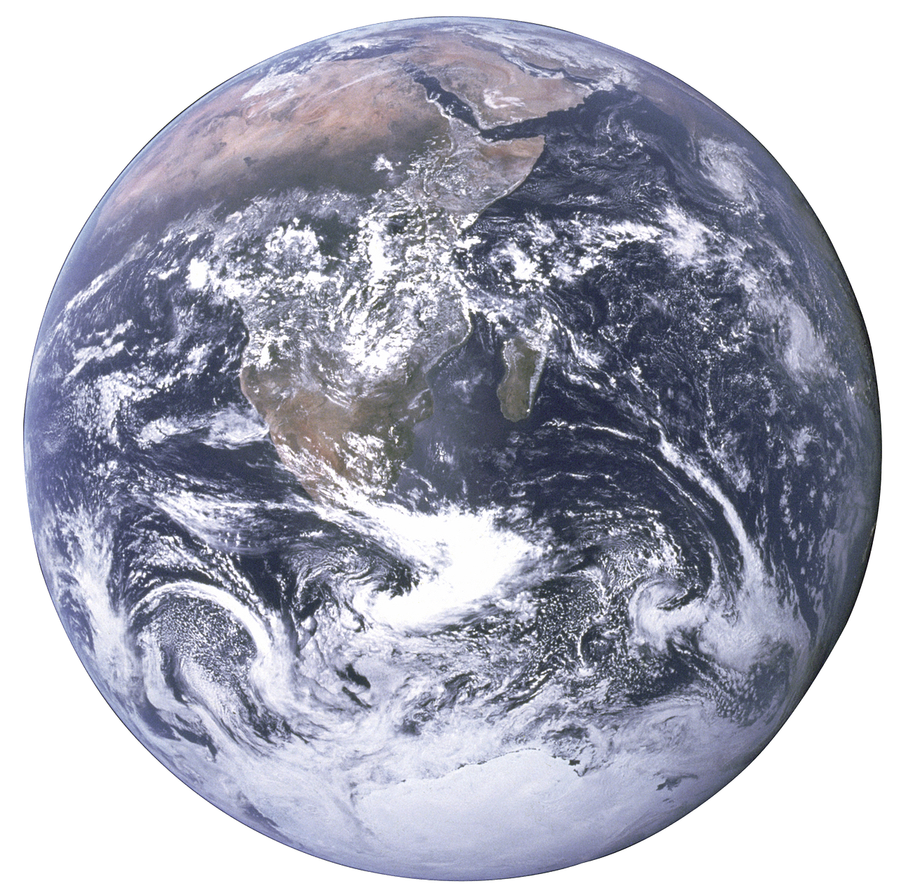
Circumference of a circle
Task B: Using a formula to calculate the diameter and radius
1) Calculate the length labelled in each diagram. Round decimals to 1 decimal place.
a)
C = 15 m
b)
C = 15π m
c)
C = 21.2 cm
u
w
u = 4.8 m
v = 15 m
w = 3.4 cm
v
d)
C = 9 mm
e)
C₁ = 14 cm
z = total height
y
C₂ = 36 cm
z
x = 1.4 mm
x
y = 2.9 mm
z = 15.9 cm
2) The diagram is a 2D representation of the International Space Station orbiting the Earth. The diagram is not drawn to scale.
a) The circumference of Earth is approximately 40 075 km.
Calculate the radius of Earth (to the nearest km).
b) The circumference of the space station’s orbit is approximately 42 590 km.
Calculate the distance between the space station and the centre of the Earth (to the nearest km).
c) How far is the space station above the ground (to the nearest km)?
International Space Station
6378 km
6778 km
400 km
Mathematics in Education and Industry
v2.3

